Slide 1
Importing Databases into Postgres
We will be using the pgAdmin4 GUI tool to install pre-existing example databases into our postgres server setups so we can work with these databases during the course. We will not be going into how to design and create databases in this course, just how SQL databases are organized and how to get information in and out of them.
There are a number of ways to load pre-existing data into a database
-load a .tar (tape archive) format file with the database on it
-run a .sql file (with an SQL script in it) that creates the database
-load individual .csv files for each table in the database
-there are probably even more methods….

Slide 2
We have three databases to install on our postgres server. The files are:
dvdrental.tar – an example of a dvd rental shop
Chinook_PostgreSql.sql- a classic example of the chinook database for an online retailer
Create_bank_postgres2.sql- this is the bank example from the book
We will have slightly different procedures for the .tar file and the two .sql files

Slide 3
A bit of terminology
Database server- the software that runs the database software and allows you to work with a database
Database- the actual files and code that make up the database, one server can handle many database
Table- SQL databases store data in tables, which are flat files in which each column is a variable and each row is an
“event” or “observation” or “individual”- just like a data frame in R or Python
SQL tables have a key that serves as an identifier for the row and must be unique for each row, a key made up of
multiple variables is called a composite key
Schema- the describtion of how a database is structured, what tables it has, how they are related and what variables each
one holds
View- a set of code that creates a report or a set of tabulated results. It is not stored like a table, but a set of commands
to create it.
Functions- perform calculations for us, just as in R and Python
Triggers- these are functions triggered by changes made to the database, they carry out safety checks or automated
operations that should be carried out if data is altered.

Slide 4
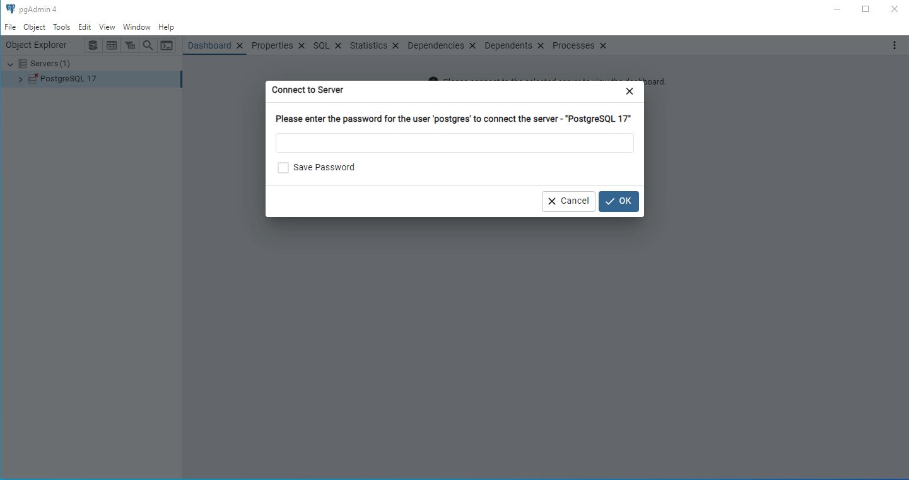
Logging in to the database from pgAdmin4
We always have to log into a database before doing anything with it. This is how to login from the pgAdmin4 gui used with Postgres
1.) Start pgAdmin4 and double click on the servers icon
2.) Enter your password for the server- this is for the superuser, whose username will be “postgres”

Slide 5
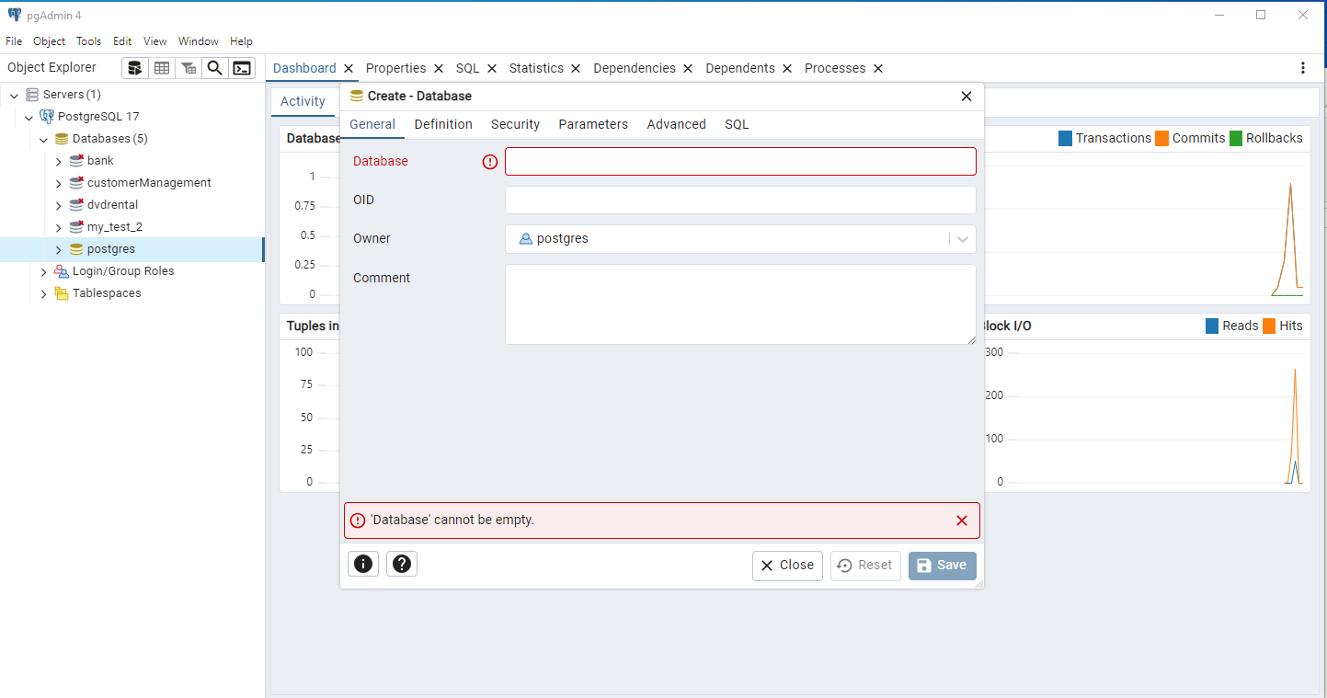
Installing dvdrental.tar
1.) Right click on the database named postgres
2.)Select Create
3.) Select Database
4.) You will get the window shown here, name your database “dvdrental”
5.) Leave the other lines blank, with the owner as postgres
6.) Click save and you should see the database appear on the left
My postgres server has databases installed, so it will look slightly different than yours, the only database you will have is called postgres which holds data on your installation.

Slide 6
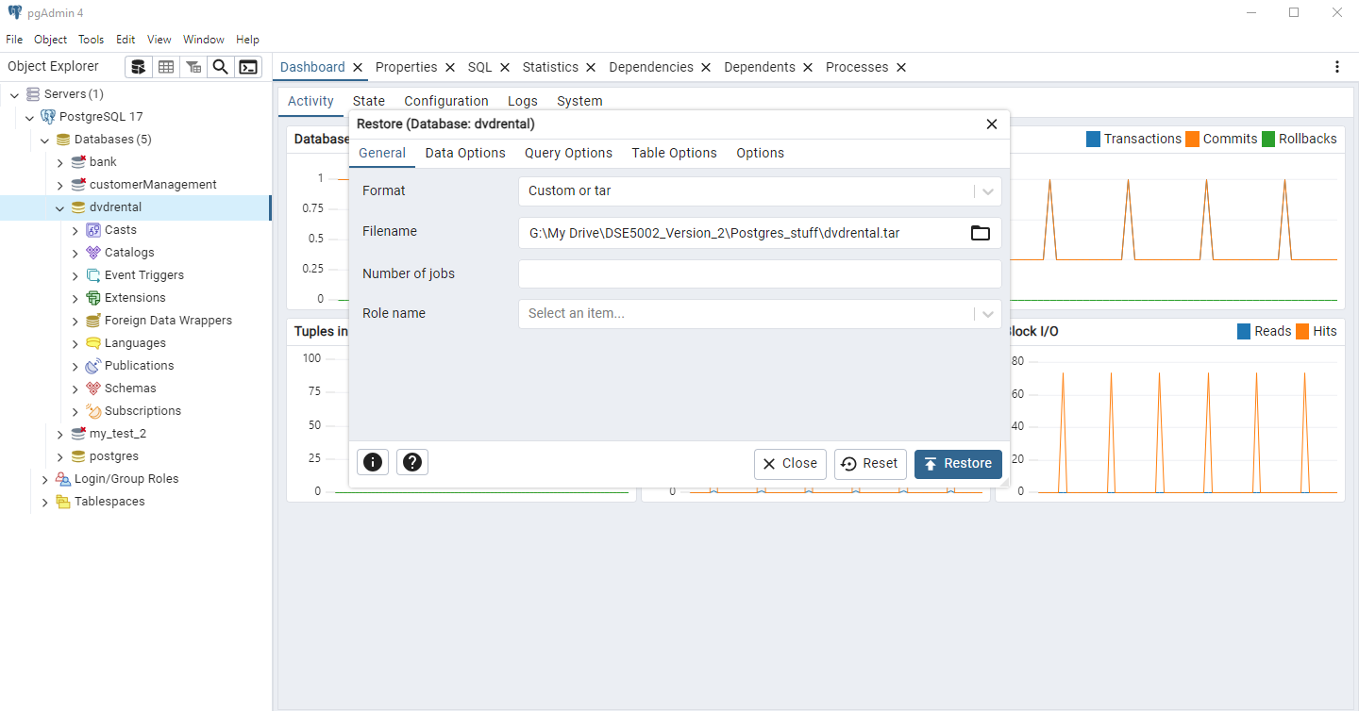
Installing dvdrental.tar- continued
1.) Right click on the database you just created, dvdrental, and select “Restore” – this means to load or reload from a .tar file
2.) use the browser (file) icon in the filename window to browse to where you stored dvdrental.tar
3) Click restore

Slide 7
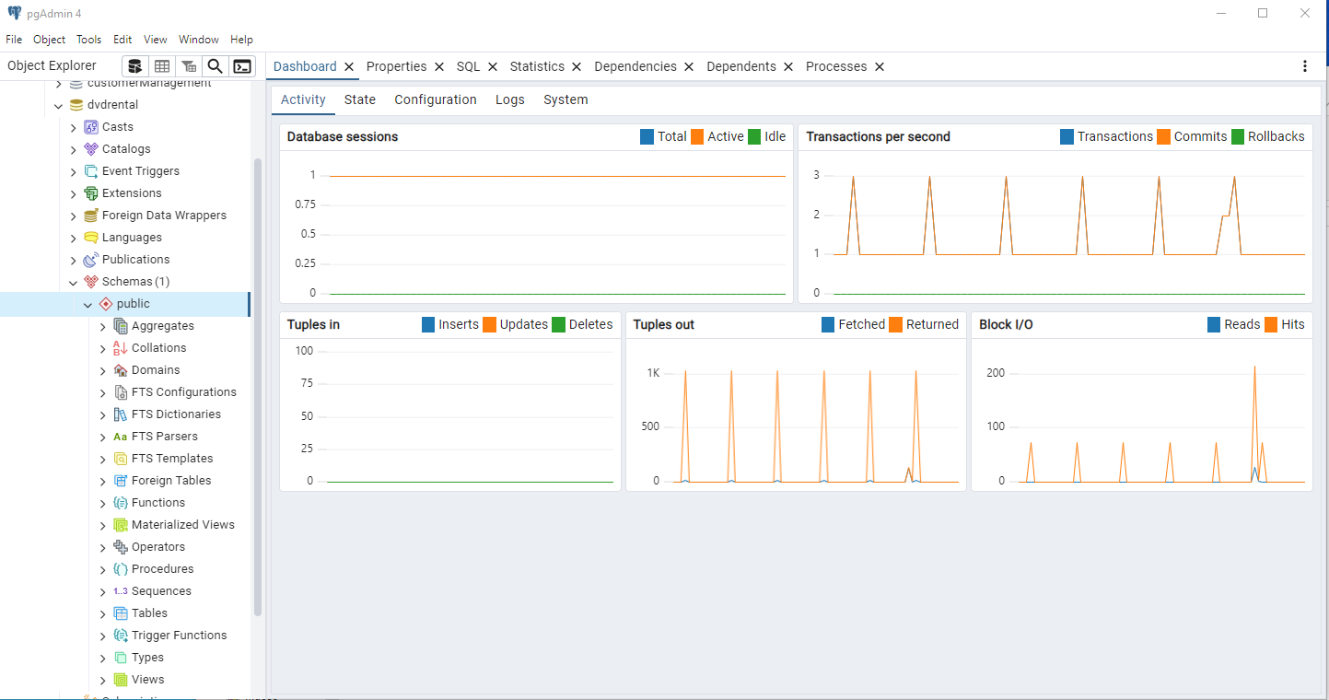
A quick look at the dvdrental database
1.) Click on dvdrental
2.) Click on schemas
3.) Click on tables

Slide 8
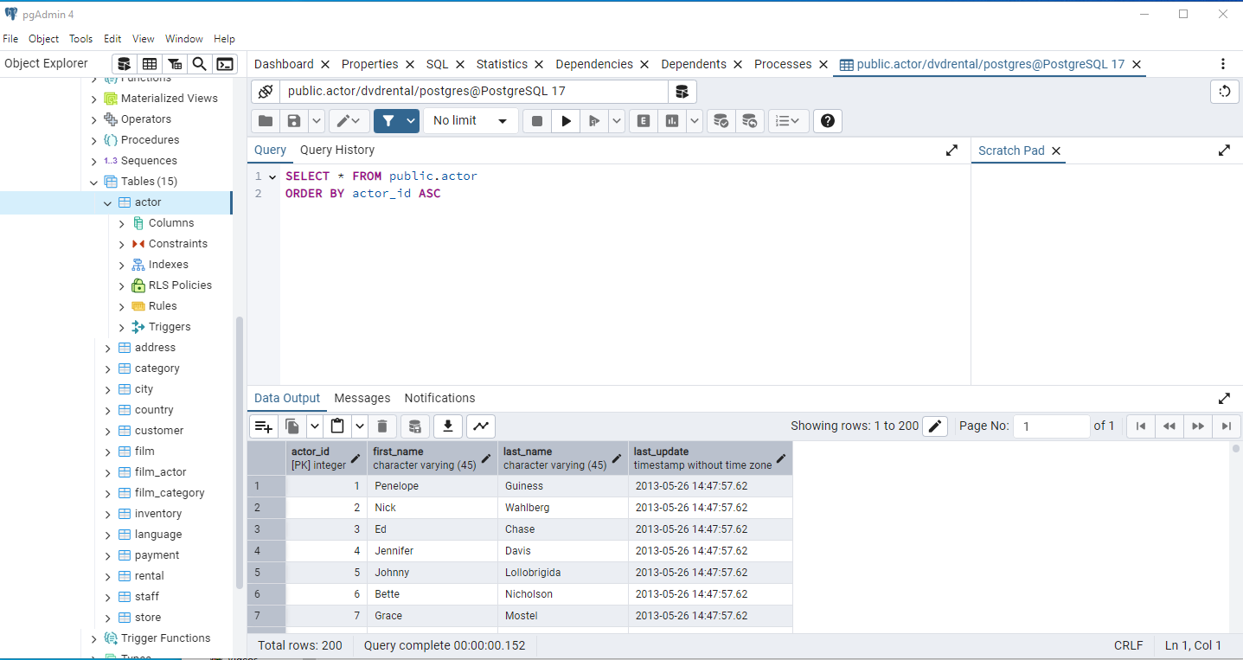
Tables in the dvdrental database
1.) Click on “Tables” which is within “Schemas”
2.) Select Actor under tables
3.) Then use the table viewer icon (looks like a waffle) on the top top to see the table

Slide 9
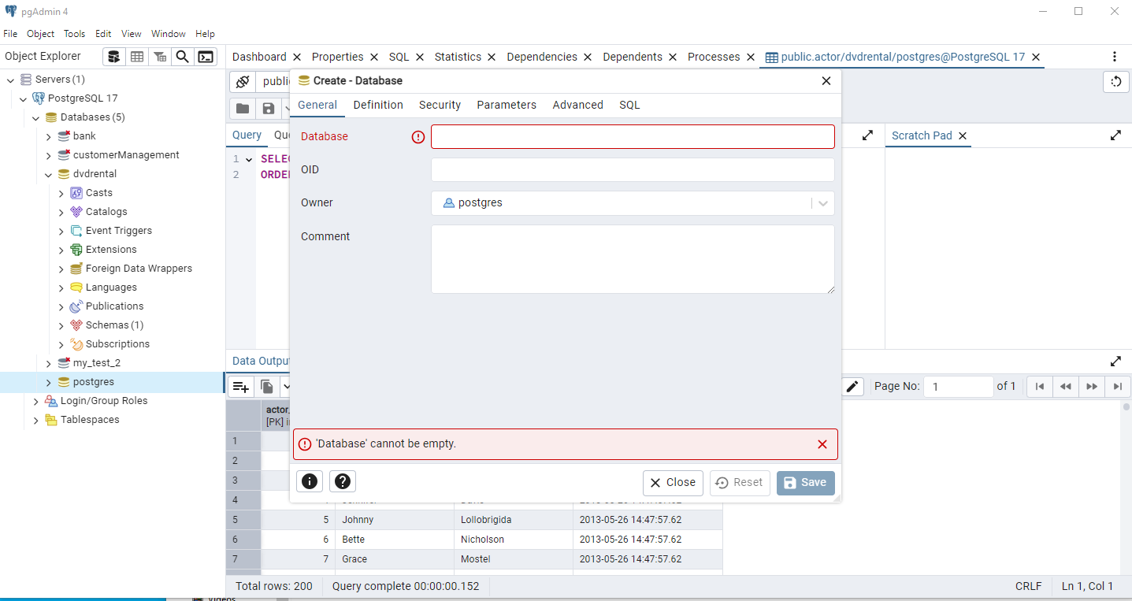
Installing the bank data set from a .sql file
1.) Go to the postgres database listing
2.) Right click and Create a new database called bank- note this is the same set of initial steps as in the install from .tar
Name your database “bank”

Slide 10
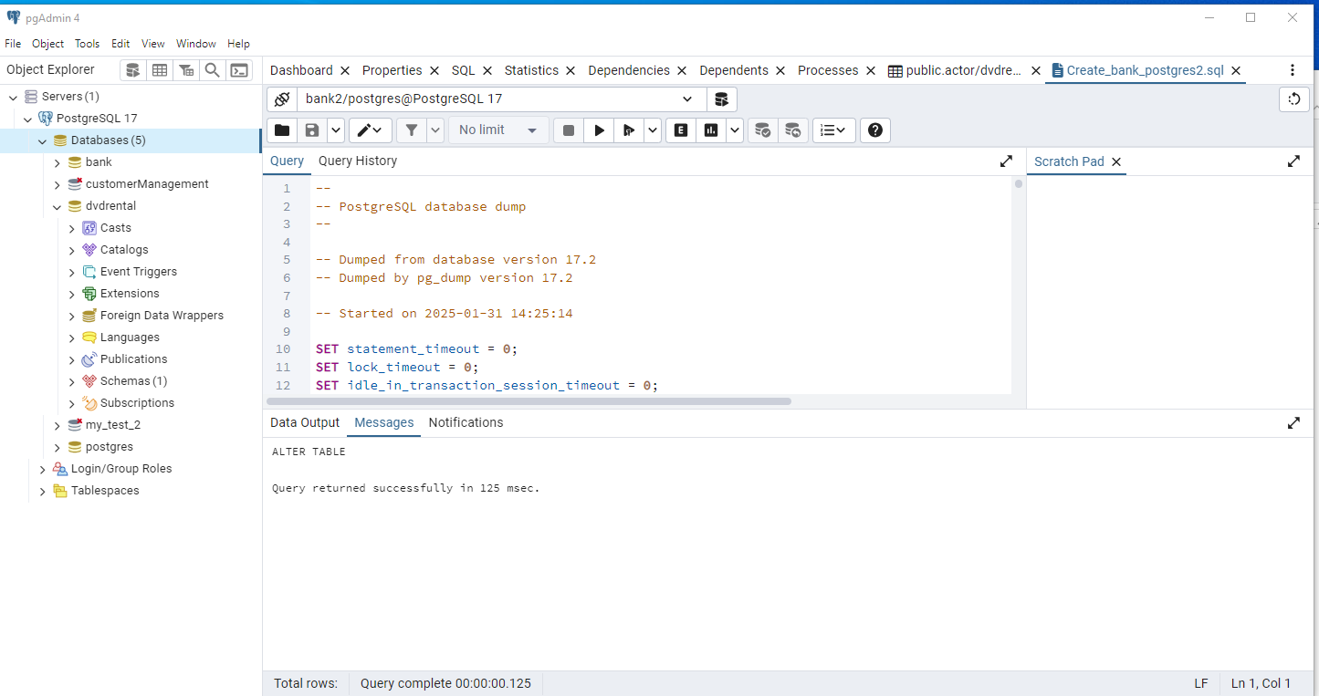
Installing bank from a .sql file
1.) Go to the bank database, and click on it, so it is selected
2.) Then to the Tools menu and select
Query Tool
3.) In Query tool, select the file Icon and load the file
“Create_bank_postgres2.sql”
4.) Click the Run Arrow to execute this .sql file and install the bank database
This section is the Query Editor, we can load pre-written scripts in to run them, or create our own queries here

Slide 11
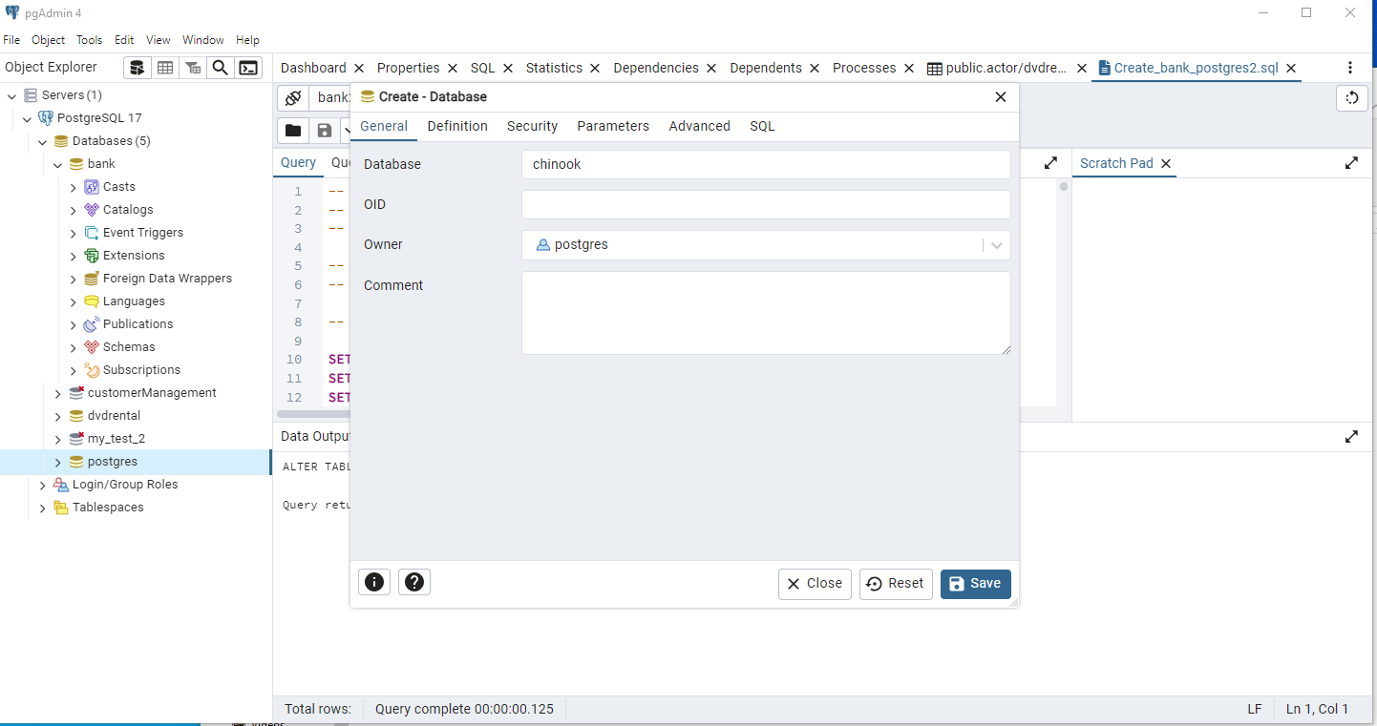
Loading Chinook from a .sql file
1.) Click on the postgress database and select “Create Database”
2.) Call the database chinook and save it
Loading chinook from a .sql file is the same process we used to install the bank database

Slide 12
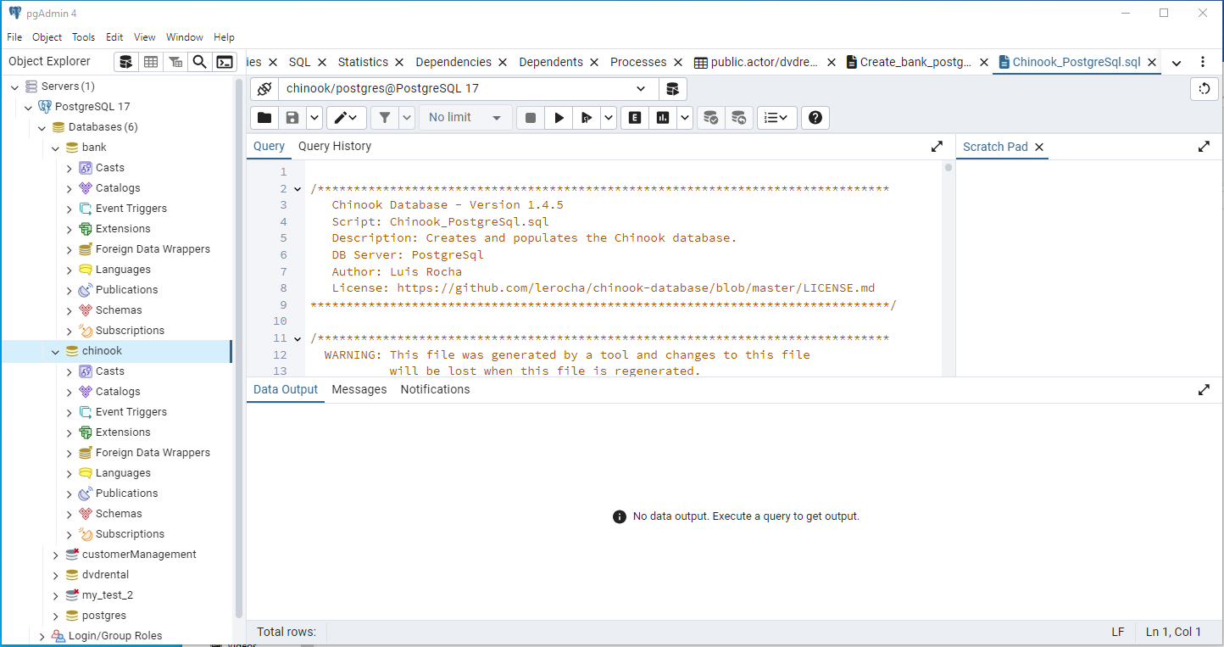
Loading Chinook continued
1.) Click on Chinook, so it is the active database
2.) Go to Tools on the menu, select query tools
3.) Use the file icon to open the file
Chinook_postgres.sql
4.) Click the run button to install the Chinook database
5.) Go to Schemas, Tables in chinook to see the tables loaded
6.) Use the “waffle” icon below the menu bar to see what is in the tables.

